Slide 1

Investigating Laptop (Sales) q2-q3 2023
Syahrul Budi Rahmadan
Hacktiv8 Technology Surabaya

Slide 2
CONTENTS
Introduction
Focus Business
Engineering Flow
Analyze and Insights
Summary

Slide 3
INTRODUCTION
From the data provided by the financial division, it was noted that the revenue obtained from the XyZ corporate Sub-Business Laptop Sales had decreased drastically. Therefore, as a data engineer also known as, I try to see and record the factors that cause this.

Slide 4
Focus business
Focus on more of our customer needs and retrain them so they can have more trust with us

Slide 5
Engineering Flow

Slide 6
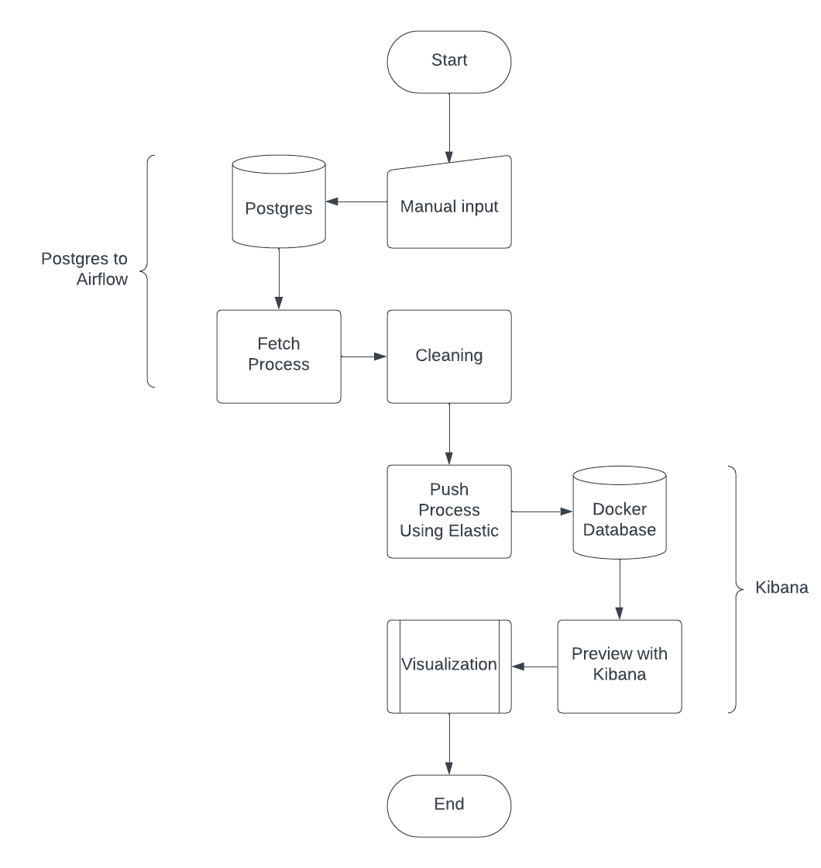

Slide 7
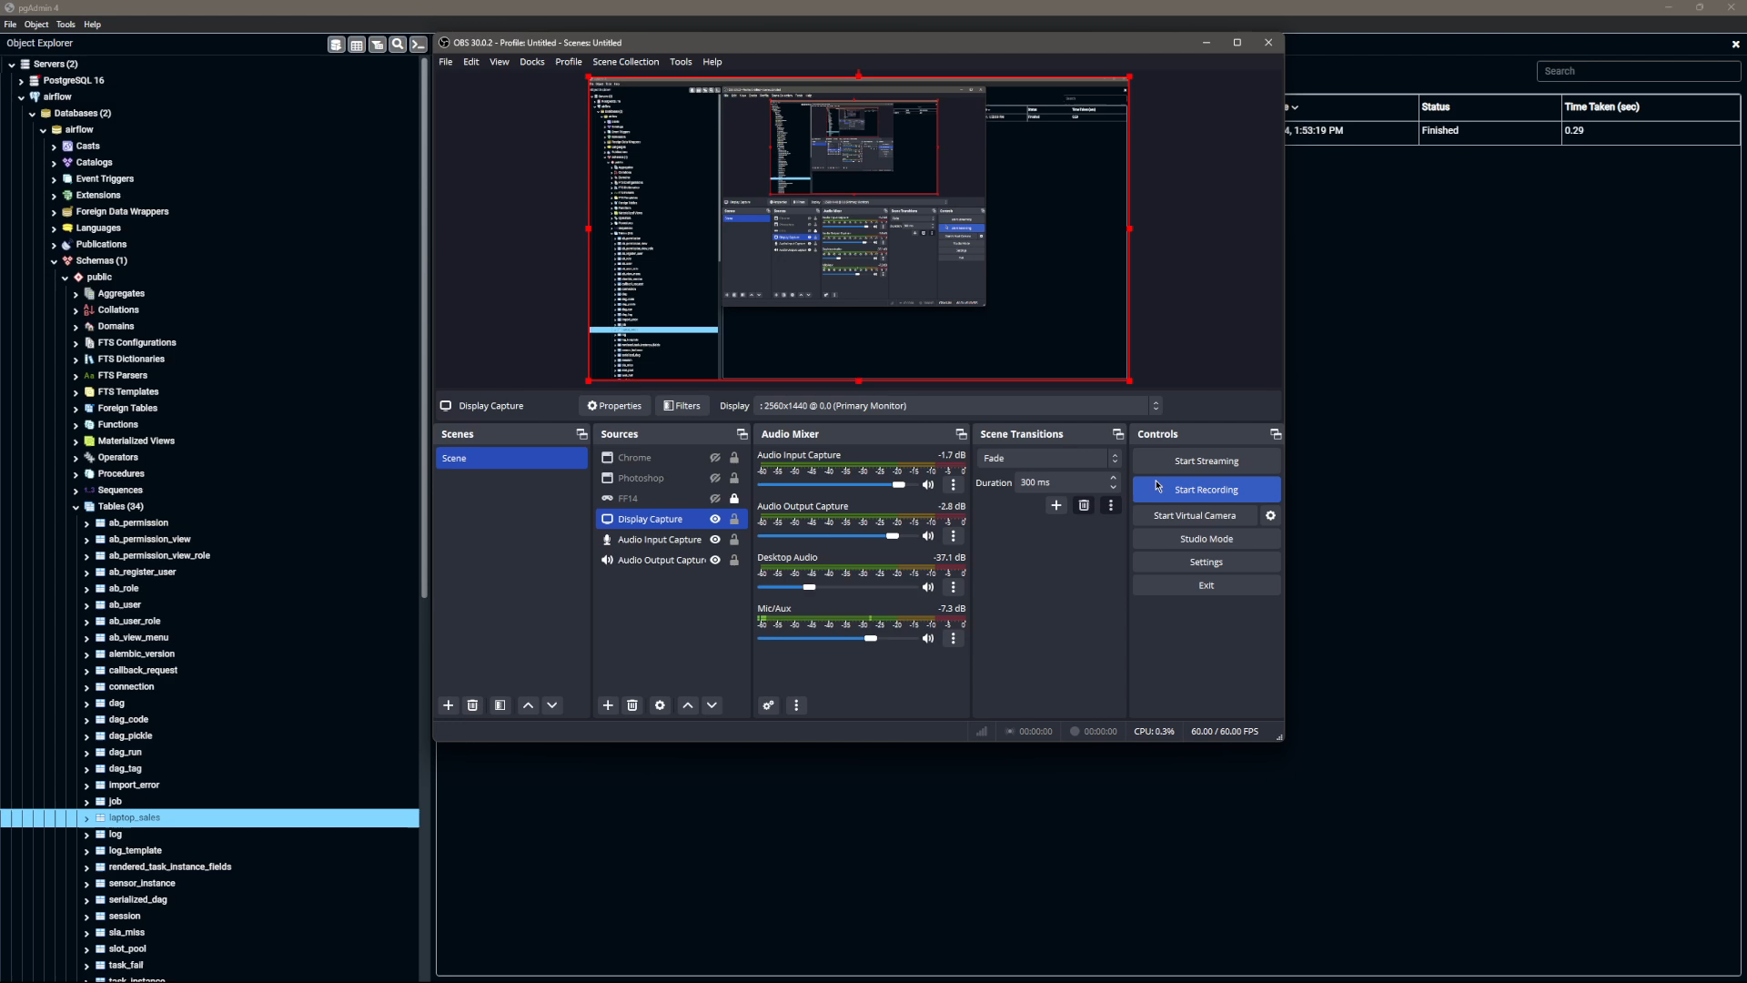

Slide 8
Analyze and Insights

Slide 9
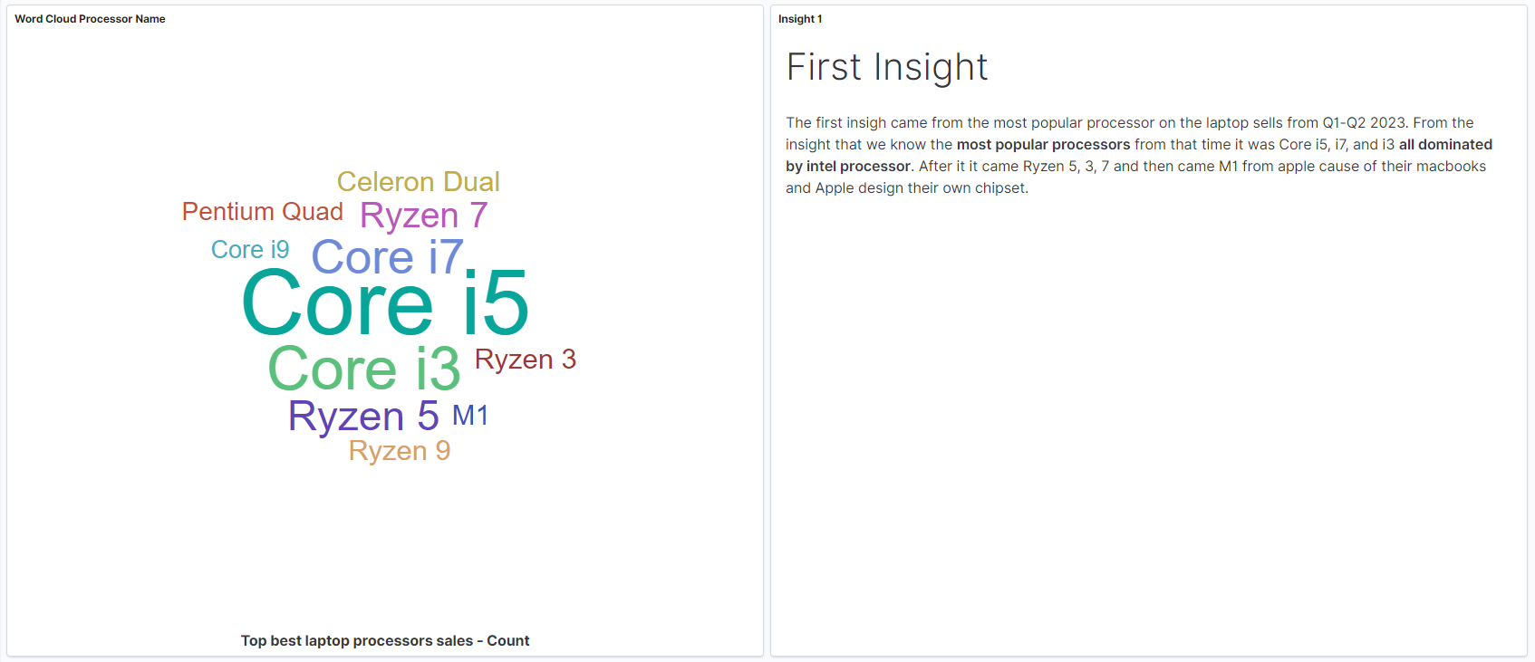

Slide 10
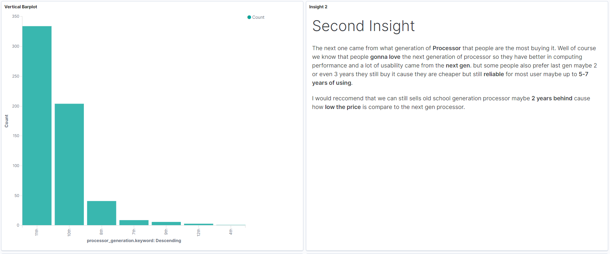
Most processor sales (generations)

Slide 11
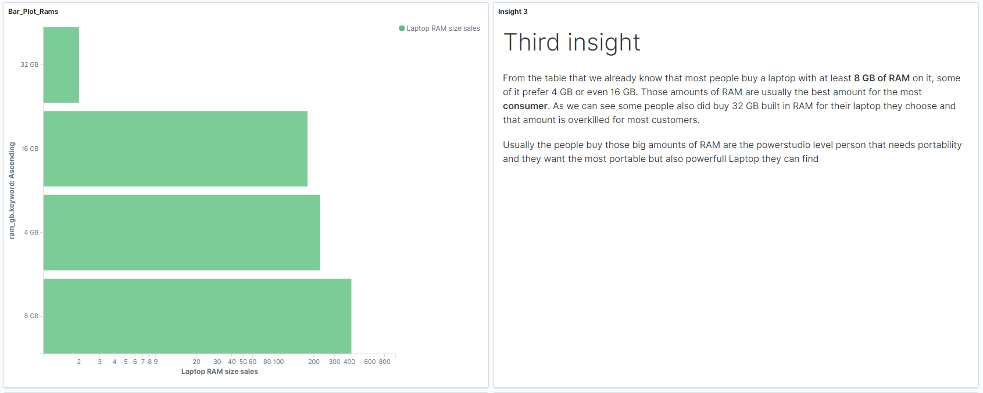
Ram configuration

Slide 12
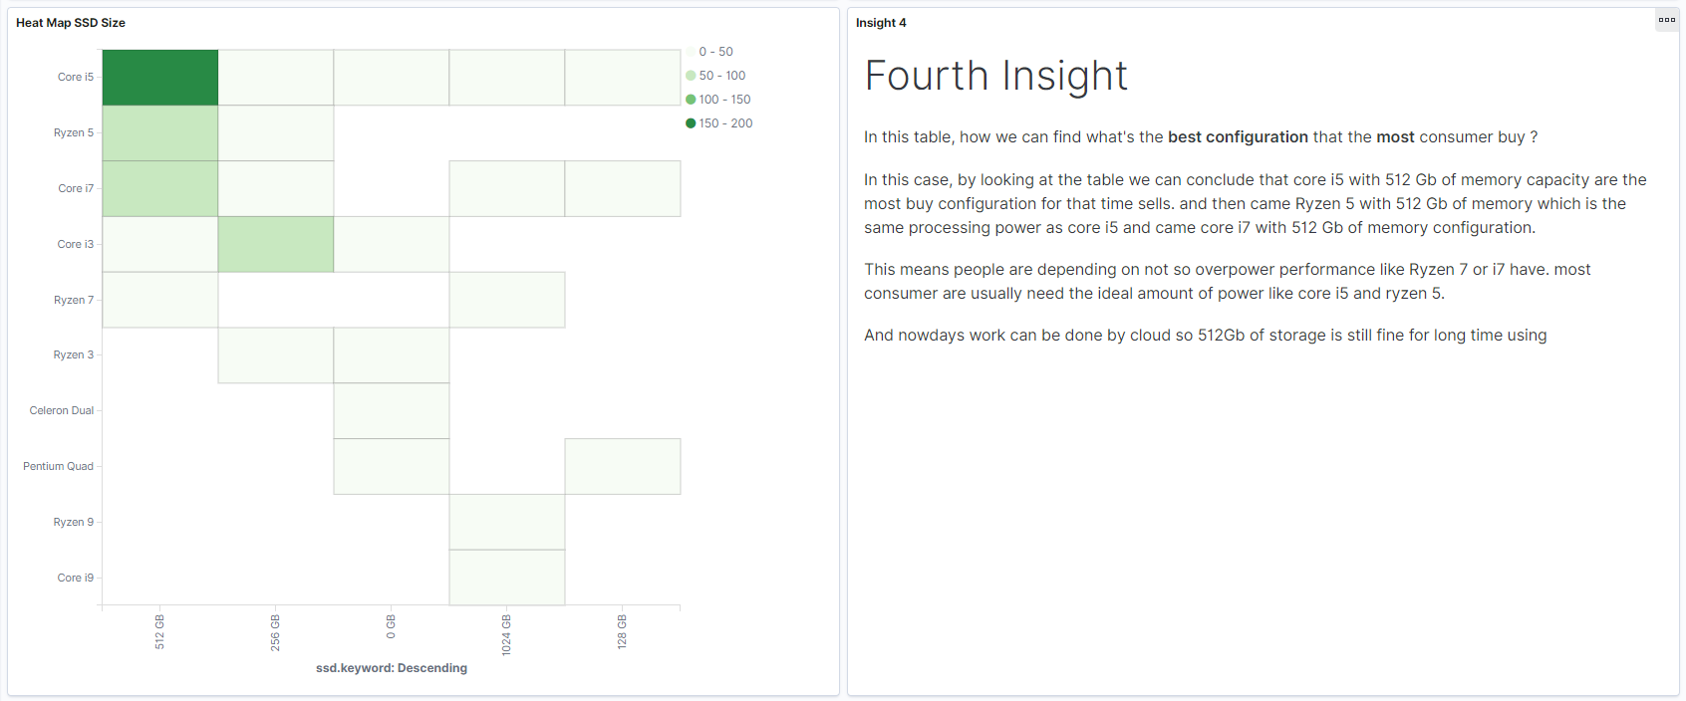
Storage to processor type

Slide 13
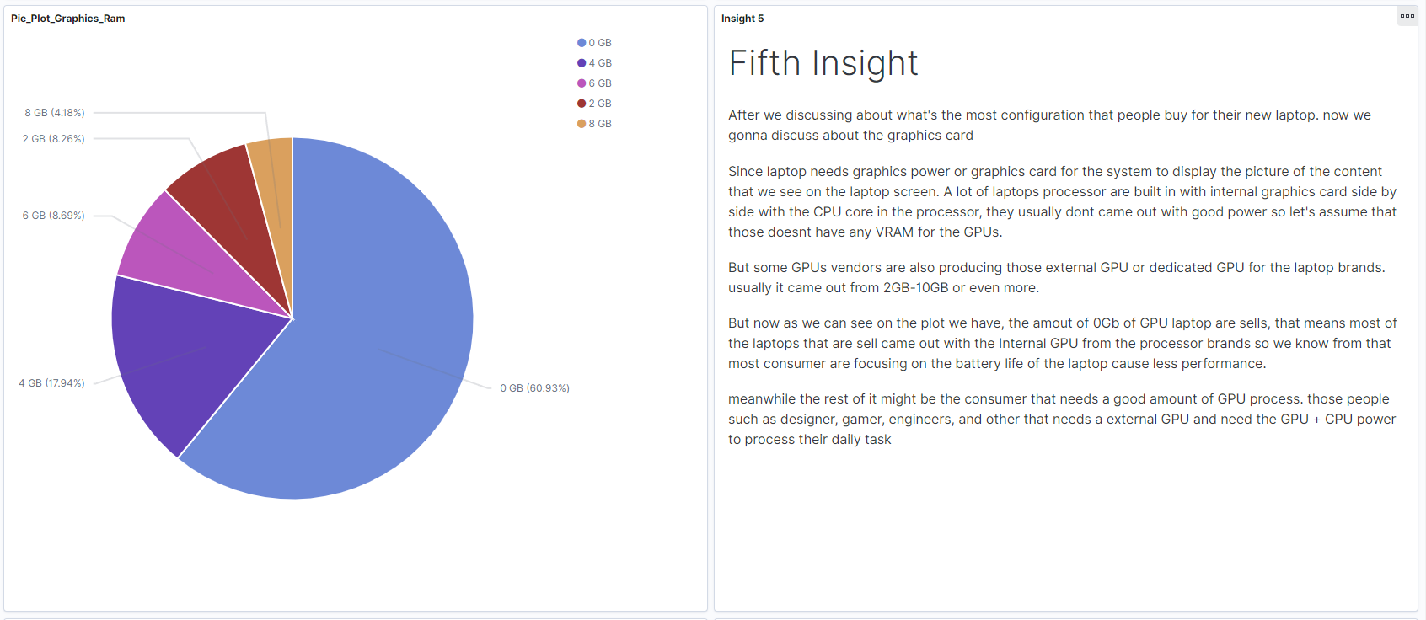
Graphic card vram

Slide 14
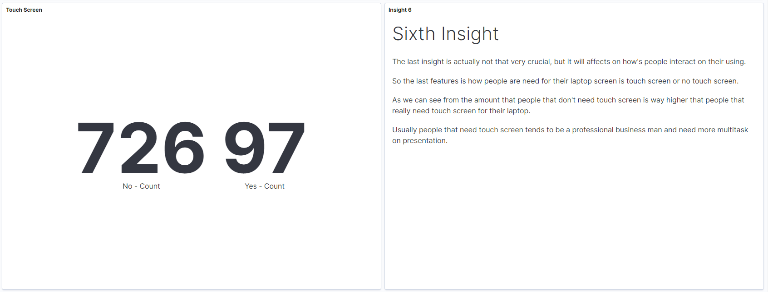
Additional features (touch screen)

Slide 15
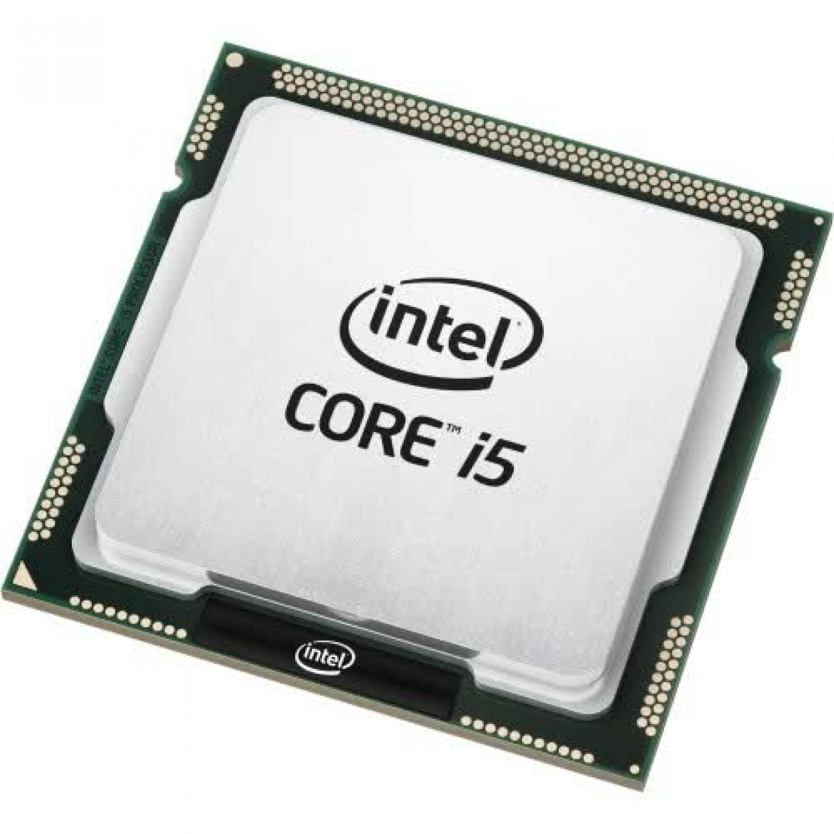
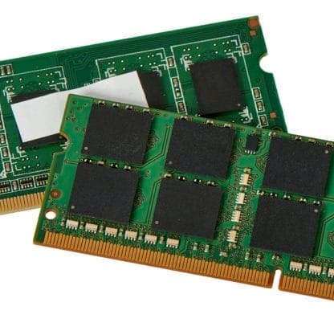
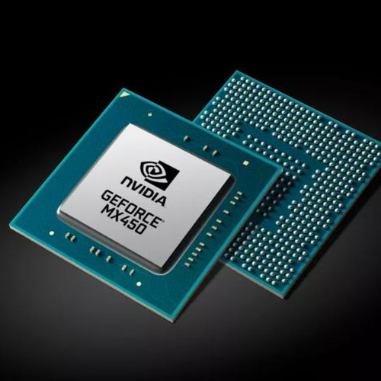
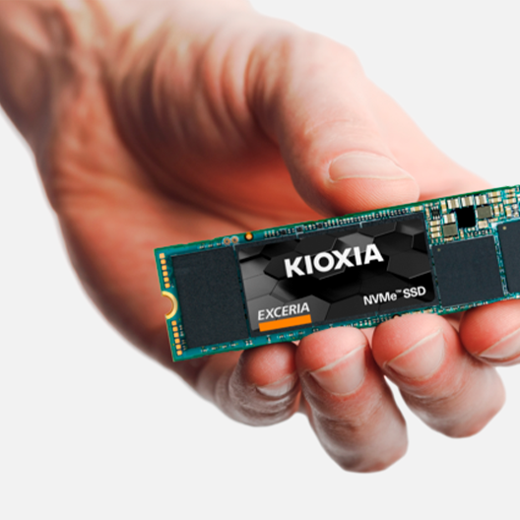
What can we focus for customer grow and retrain ?
Processor
RAM
Graphics Card
Storage
Customer needs efficient performance
For multitasking
Advance Task
Store more data

Slide 16
Thank you
Syahrul Budi Rahmadan
Hacktiv8 Technology Surabaya

